Slide 1
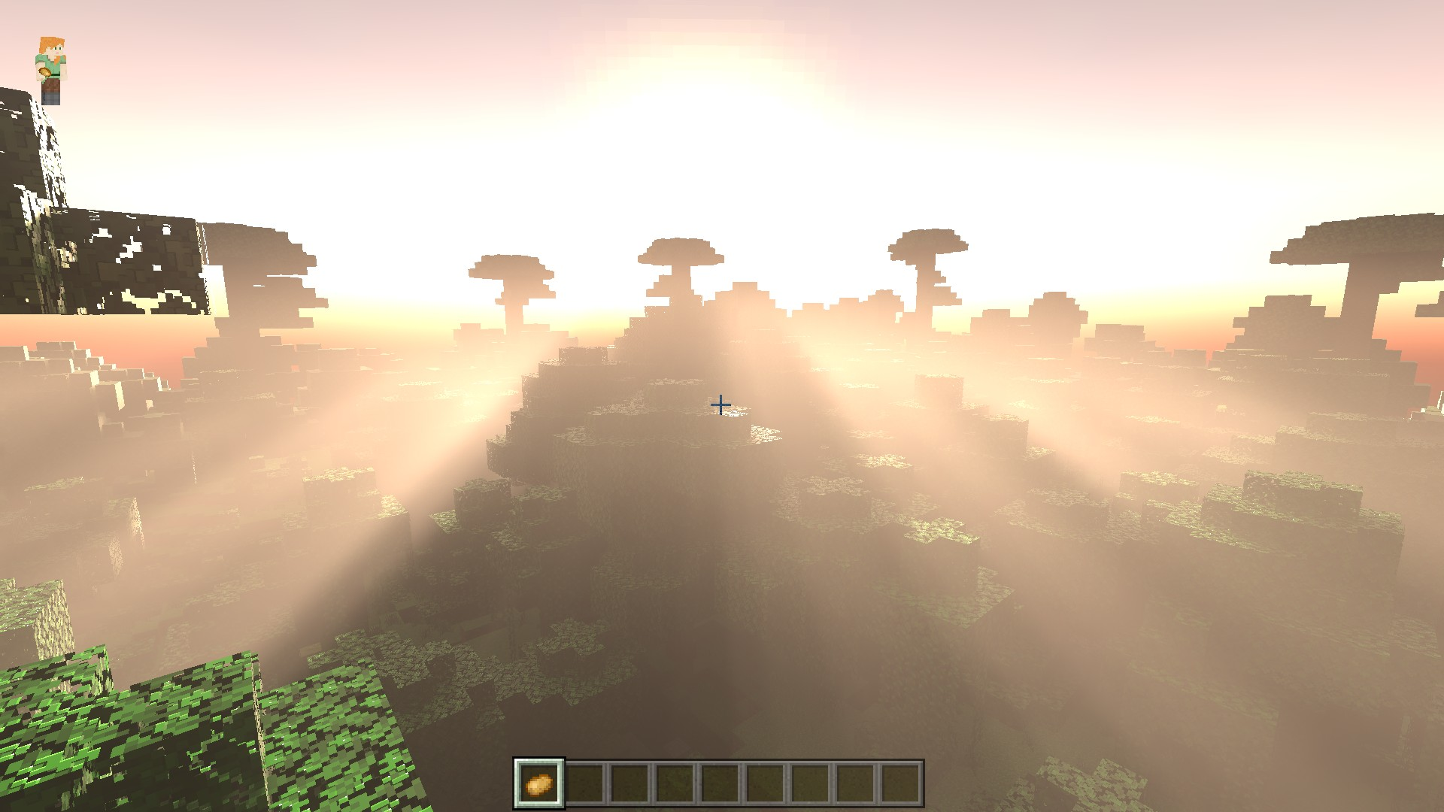
RAY TRACING

Slide 2
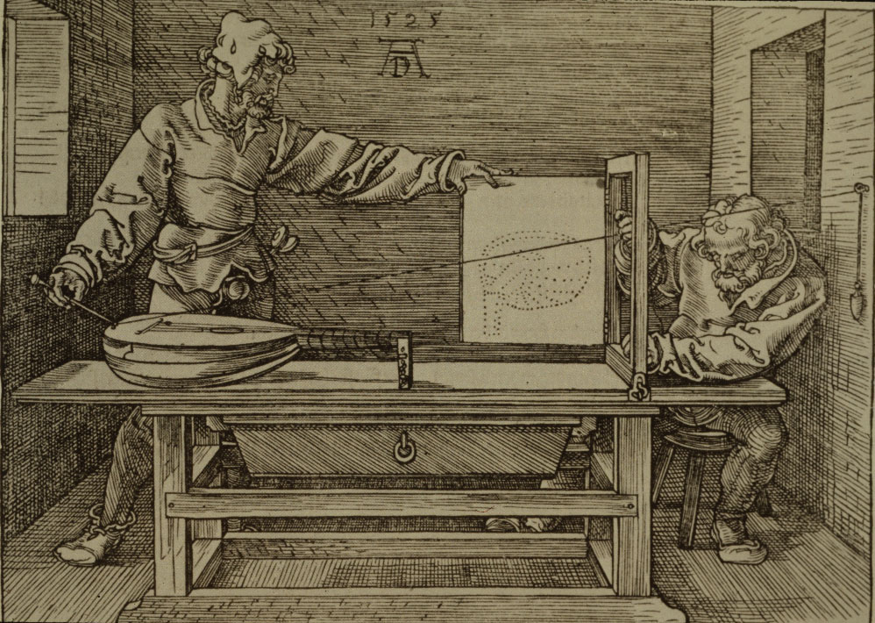
ISTORIA TEHNICII RAY TRACING

Slide 3
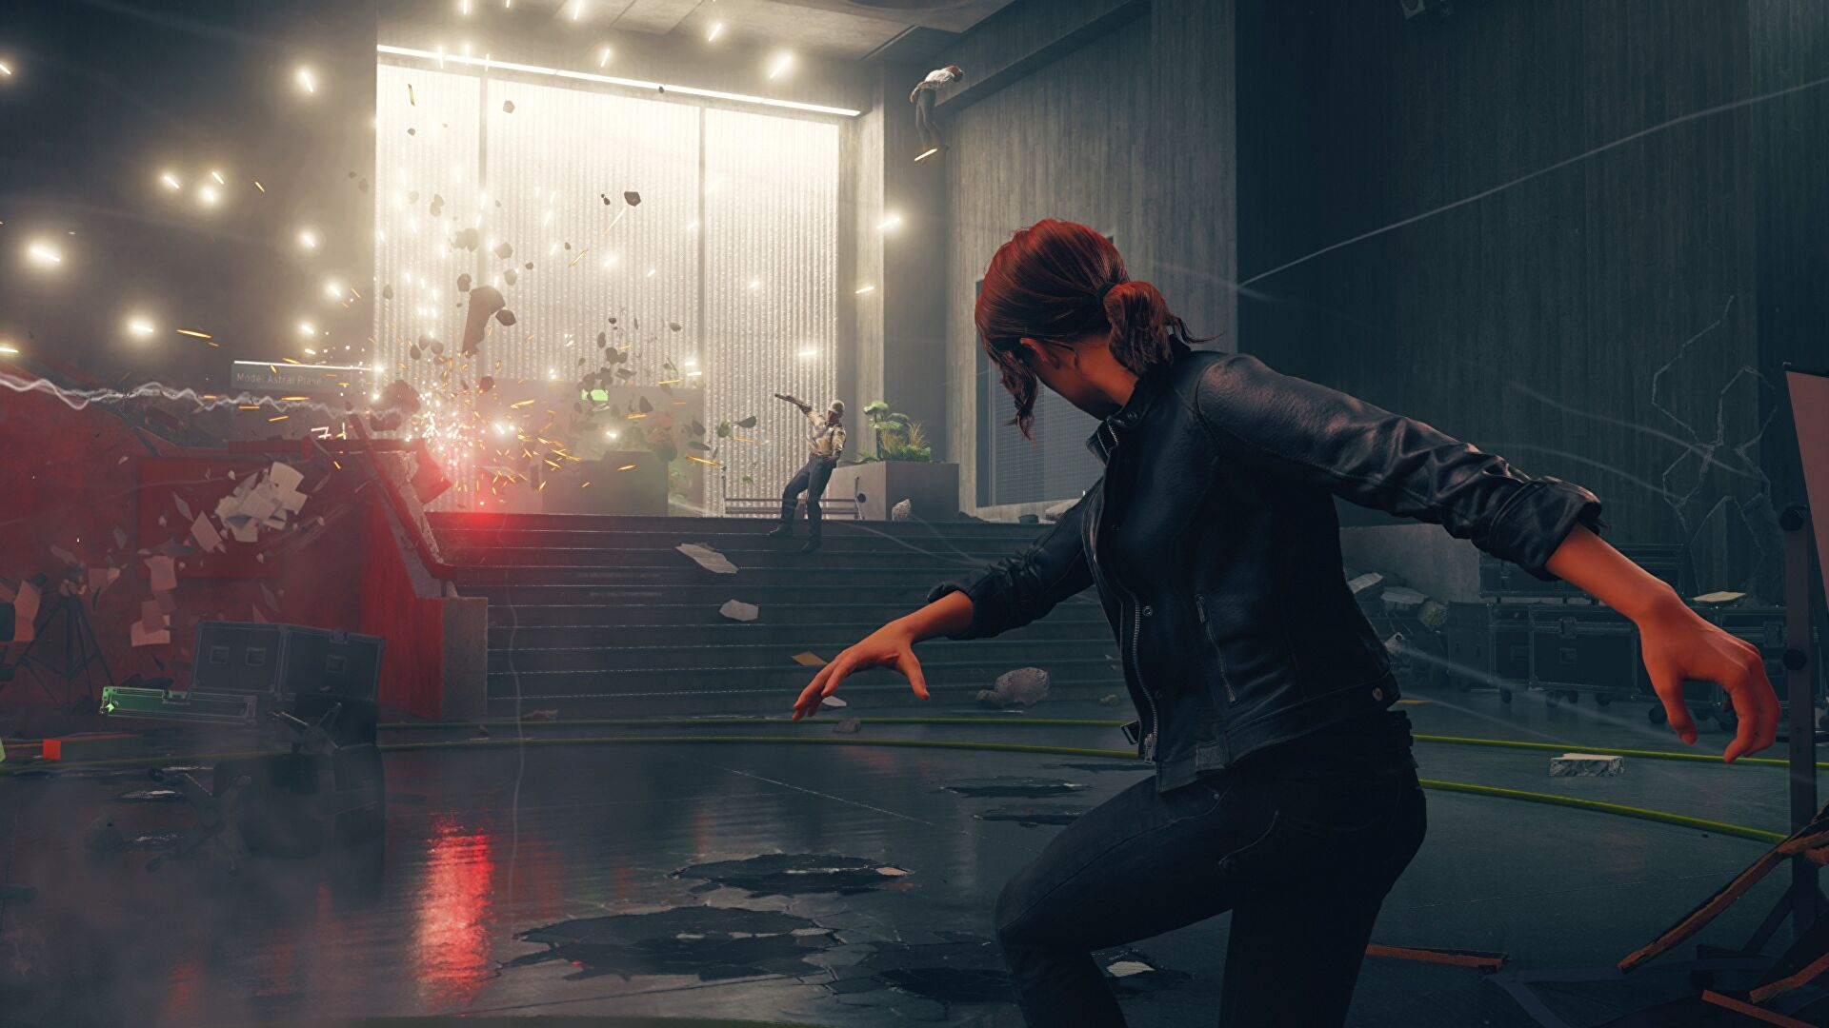
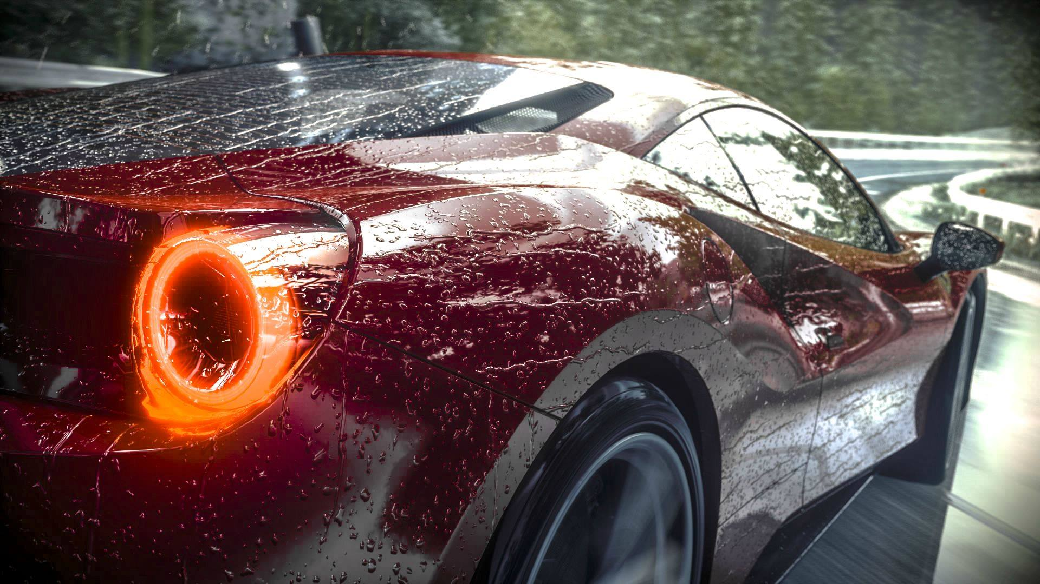
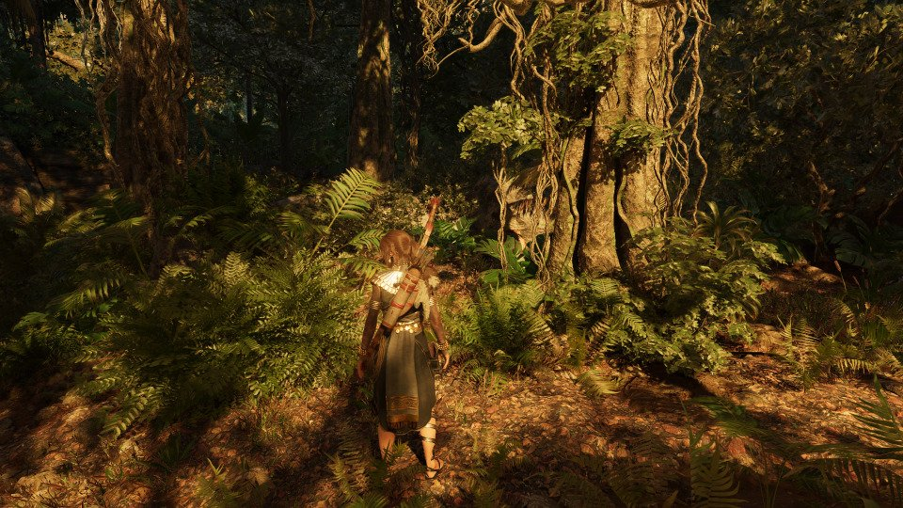
RAY TRACING
... ÎN DIFERITE INDUSTRII

Slide 4
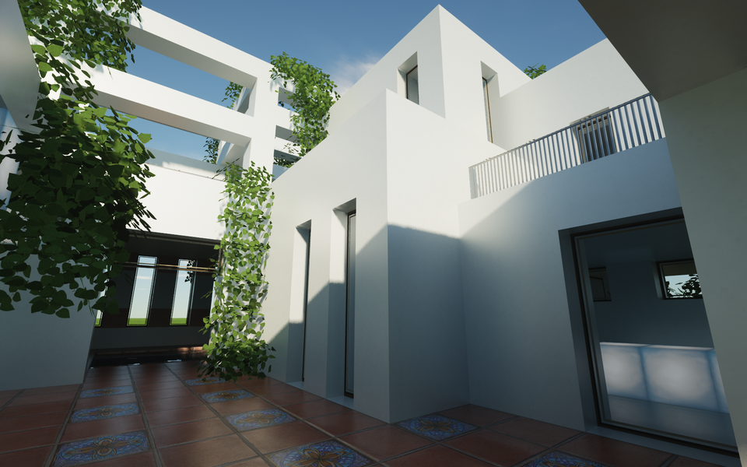

DE CINE ESTE FOLOSITĂ

Slide 5

DE CINE ESTE FOLOSITĂ

Slide 6

DE CINE ESTE FOLOSITĂ

Slide 7
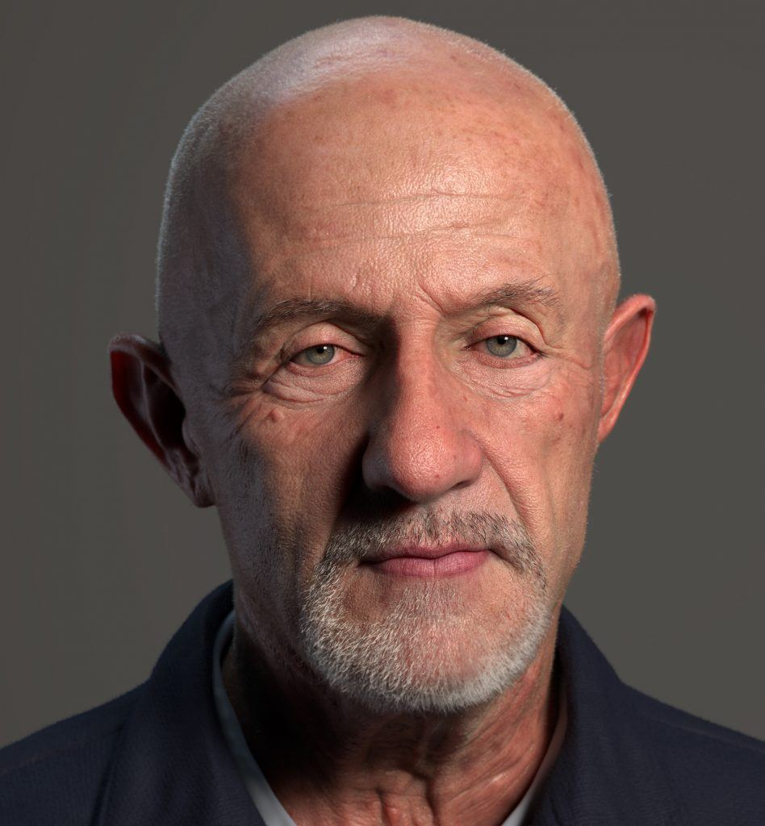
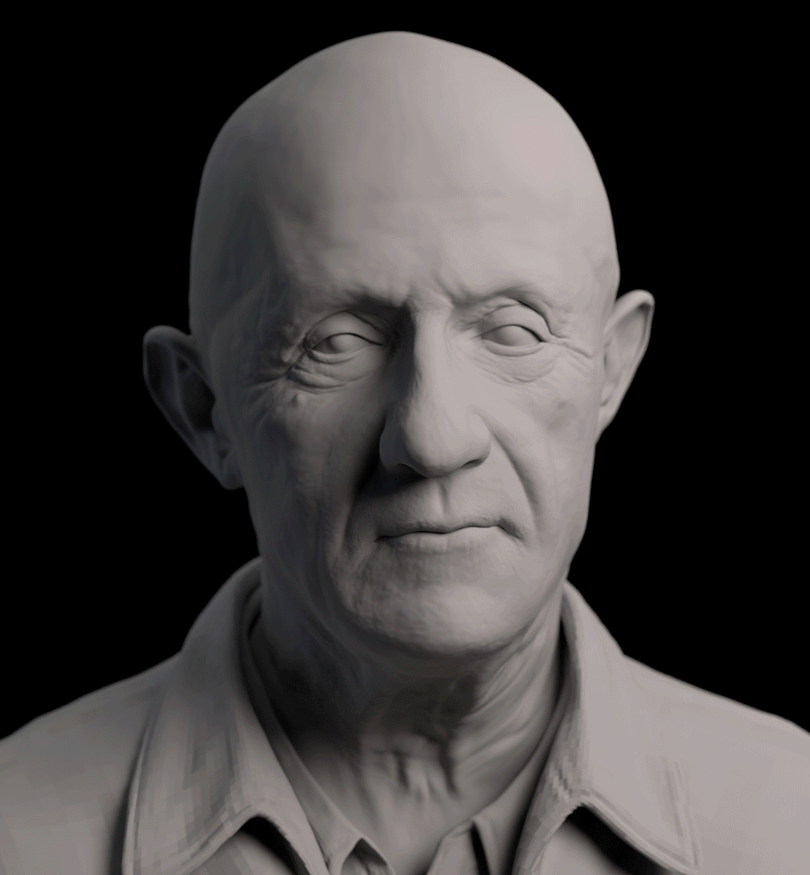
DE CINE ESTE FOLOSITĂ
@ KUBISI ART

Slide 8
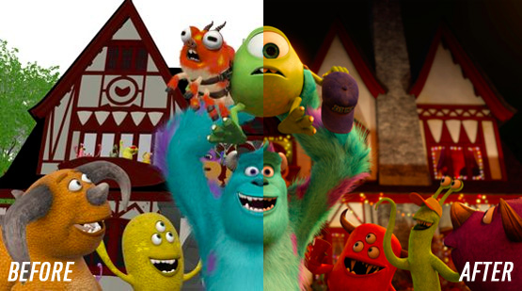

DE CINE ESTE FOLOSITĂ

Slide 9

DE CINE ESTE FOLOSITĂ

Slide 10
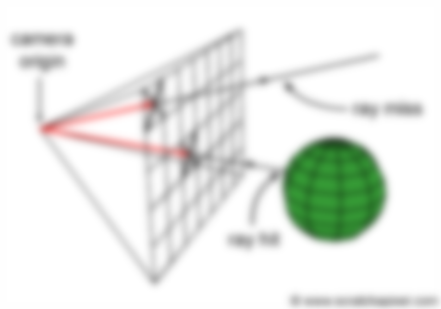
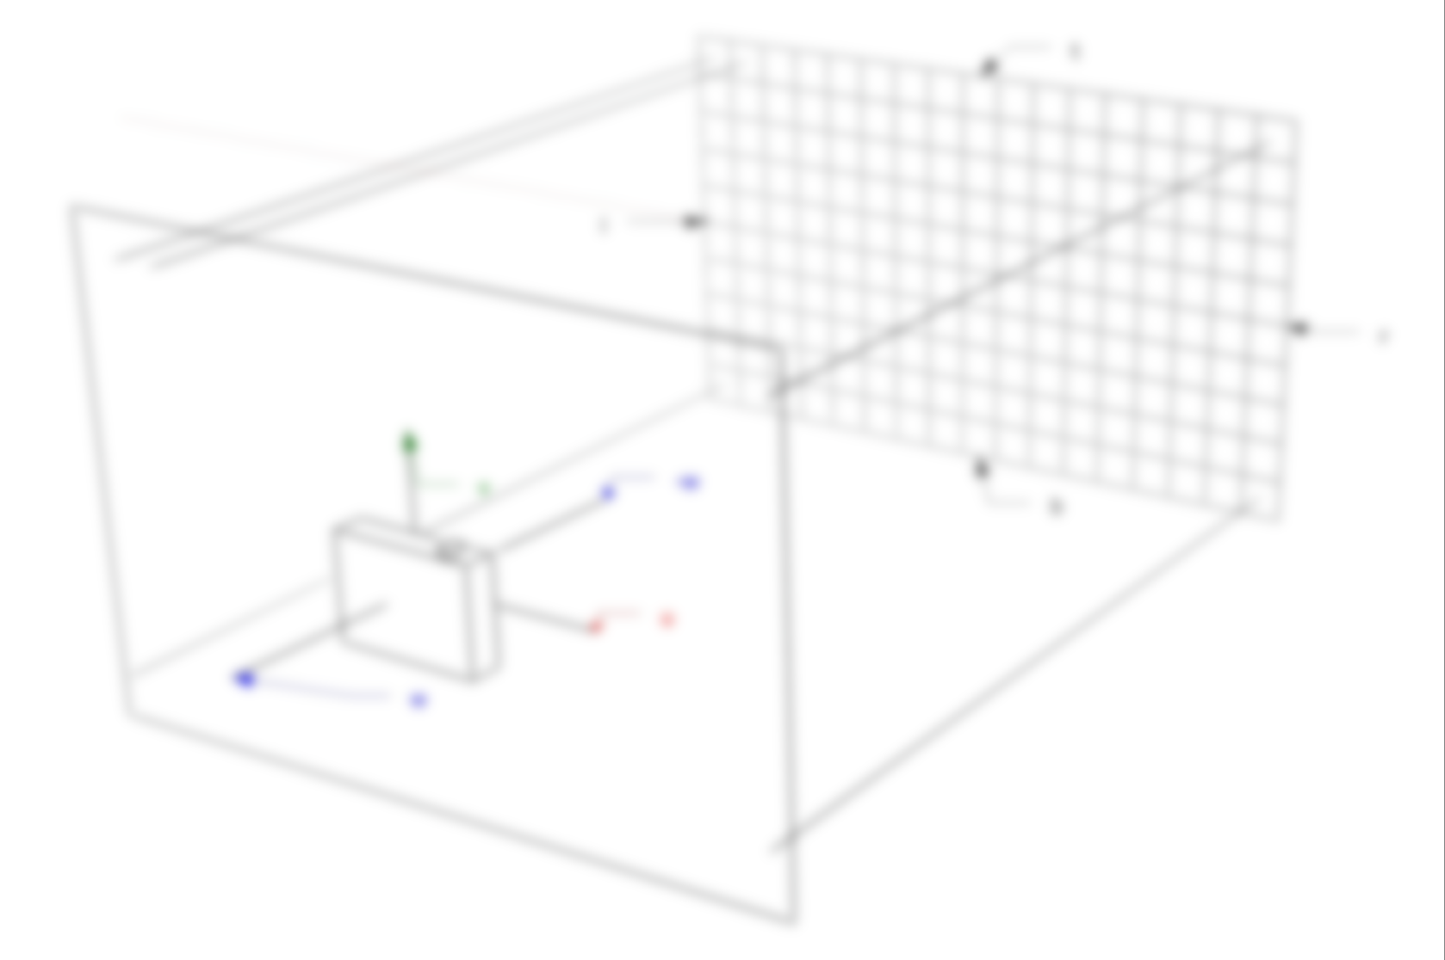
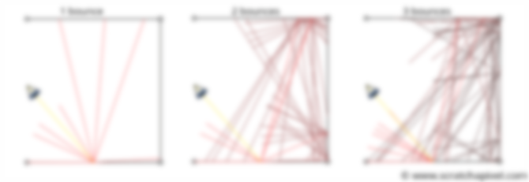
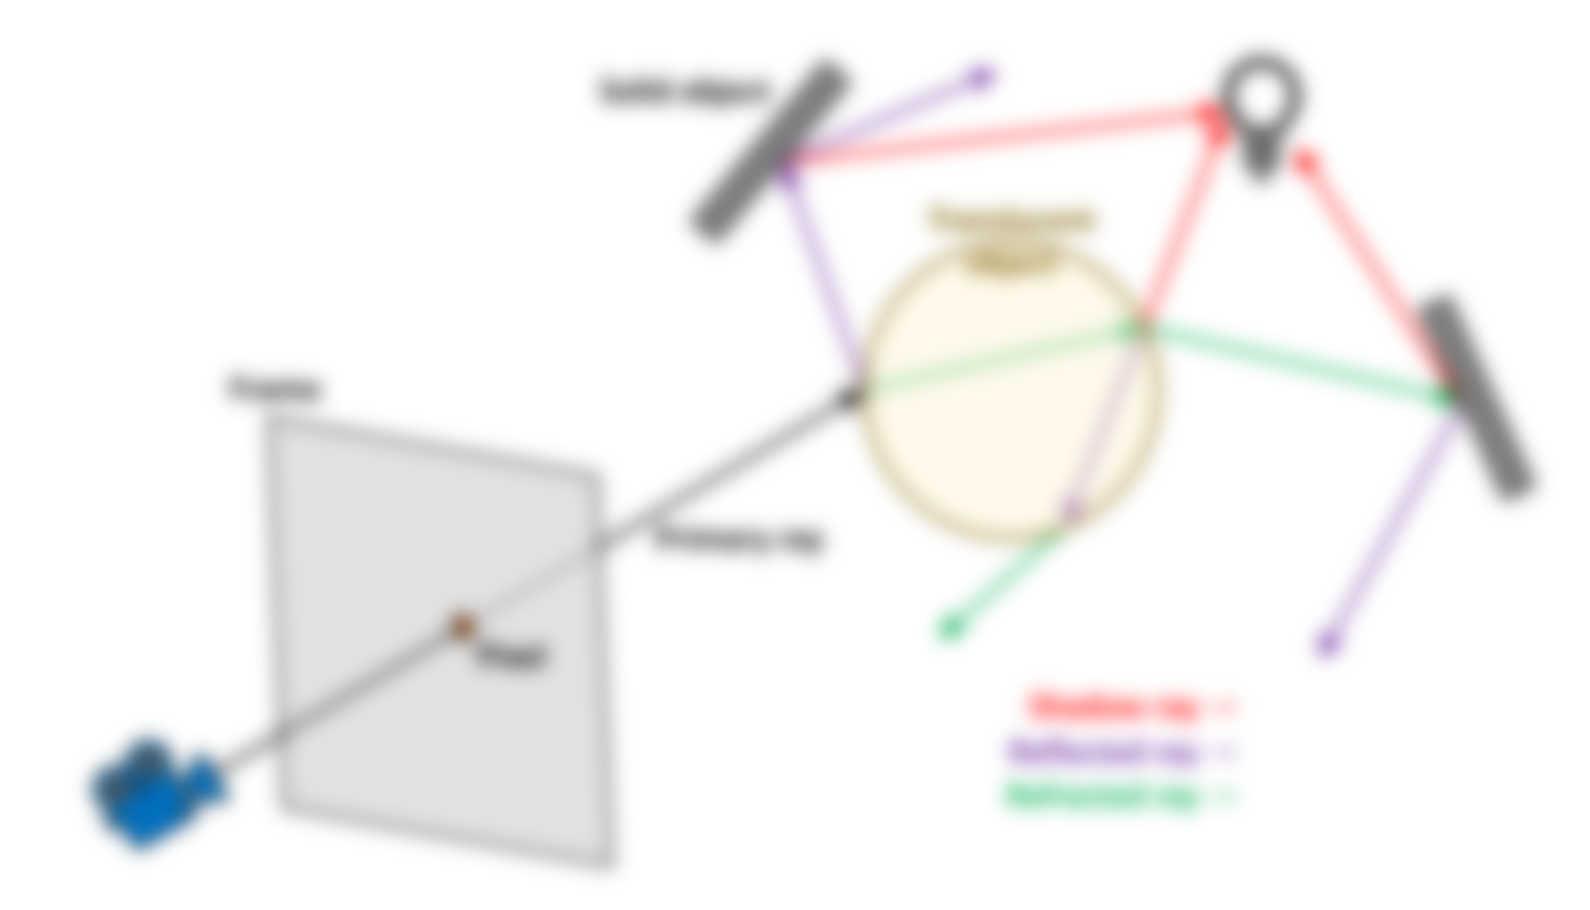
RAY TRACING
... SI CUM FUNCTIONEAZĂ

Slide 11
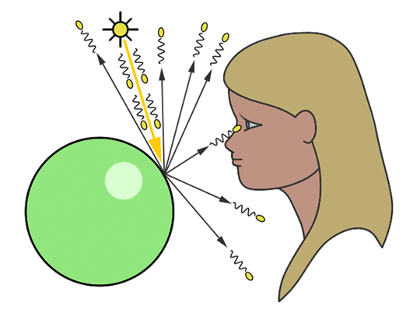
CUM FUNCTIONEAZĂ - LBRT
Light Based Ray Tracing [LBRT]:
Razele pornesc de la sursa de lumină și se propagă în toate direcțiile
Unele raze lovesc sfera
Razele care lovesc sfera ricoșează în diferite direcții
Unele raze care ricoșează ajung în ochi

Slide 12
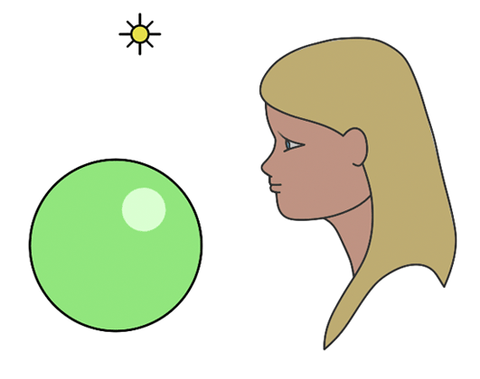
CUM FUNCTIONEAZĂ - EBRT
Eye Based Ray Tracing [EBRT]:
Razele pornesc de la ochi
Majoritatea razelor lovesc sfera
Razele care lovesc sfera ricoșează în diferite direcții
Unele raze care ricoșează ajung la sursa de lumină

Slide 13
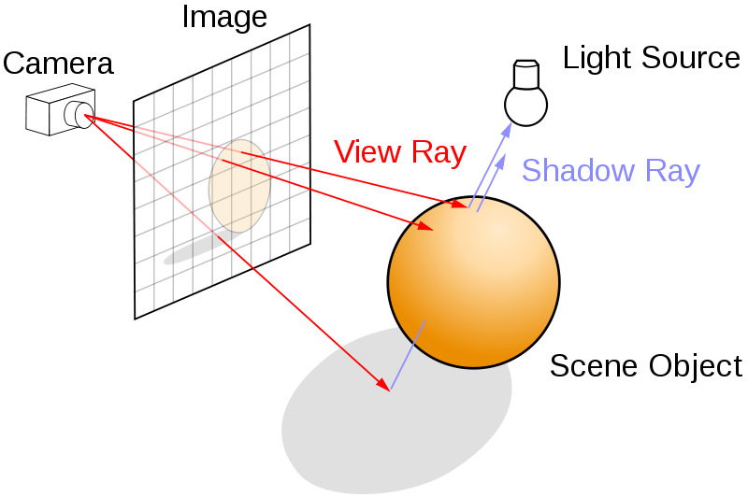
CUM FUNCTIONEAZĂ - EBRT

Slide 14
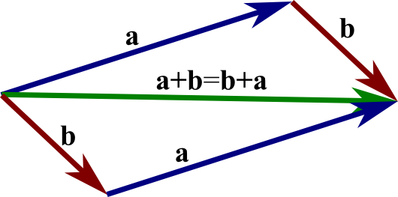
CUM FUNCTIONEAZĂ
[avem nevoie de vectori]

Slide 15
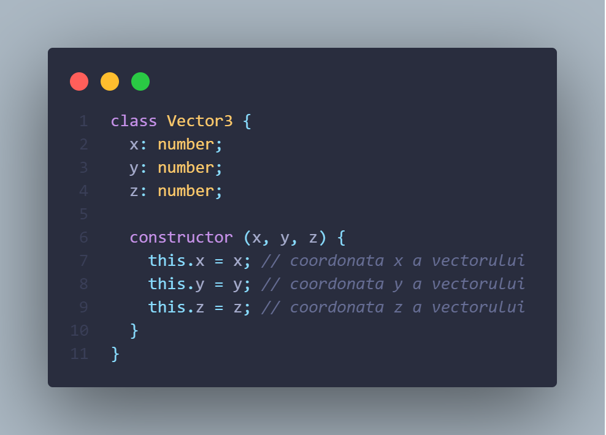
IMPLEMENTARE VECTORI

Slide 16
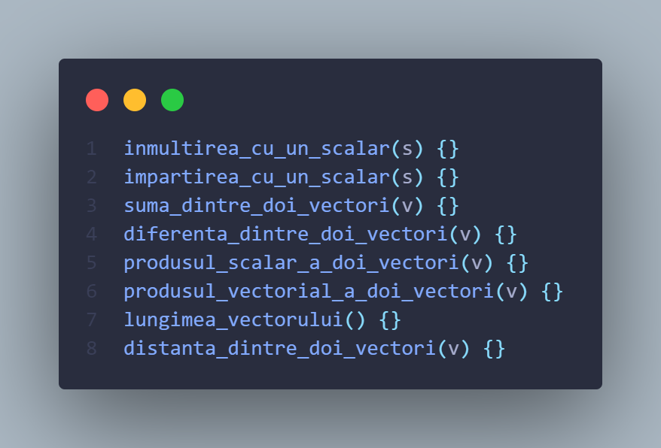
IMPLEMENTARE VECTORI

Slide 17
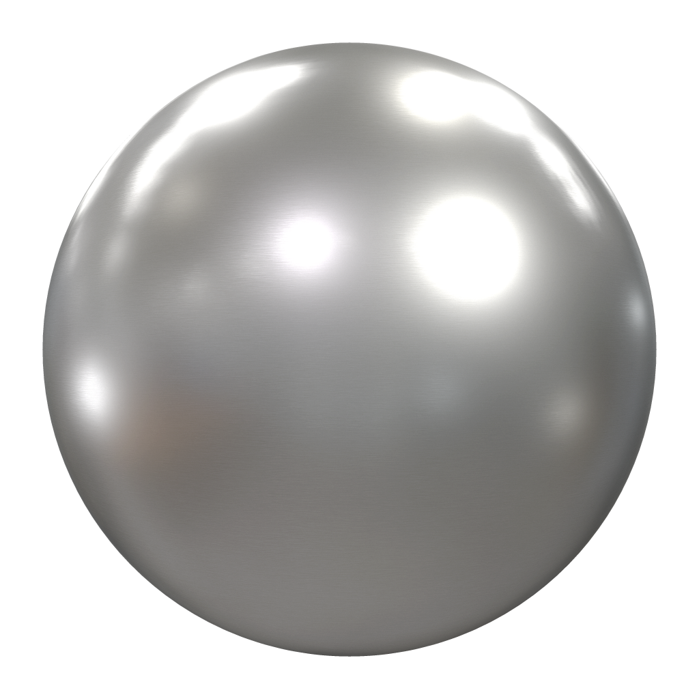

CUM FUNCTIONEAZĂ
[avem nevoie de raze de lumină]

Slide 18
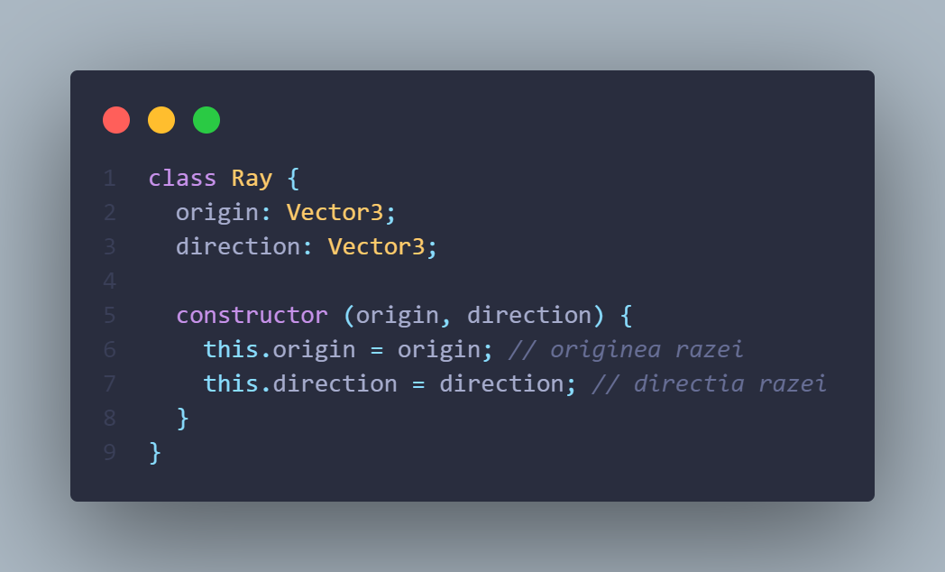
IMPLEMENTARE RAZE

Slide 19
CUM FUNCTIONEAZĂ
[avem nevoie de un punct de intersecție]

Slide 20
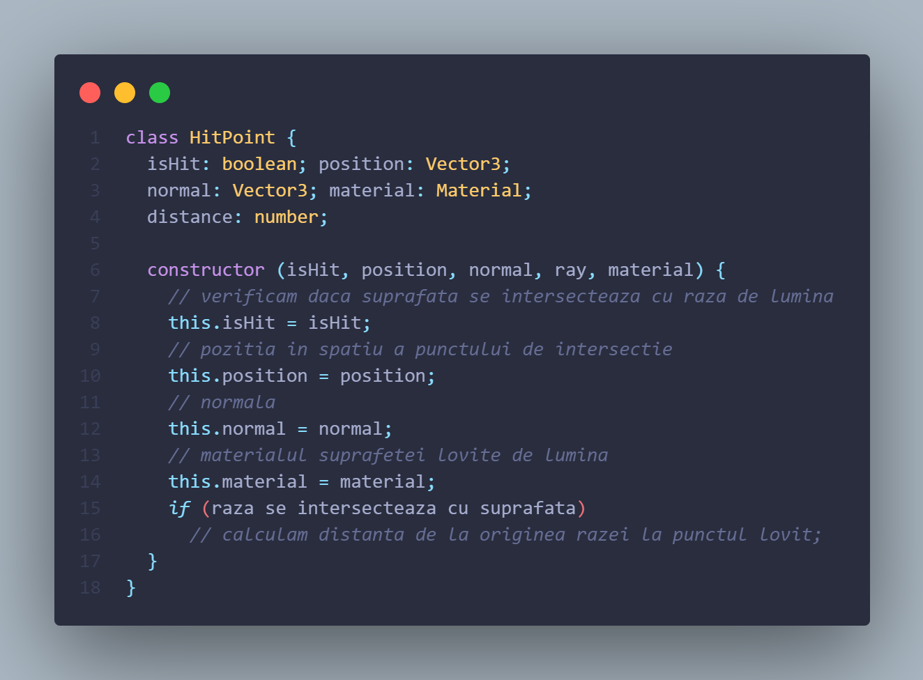
IMPLEMENTARE PUNCT

Slide 21
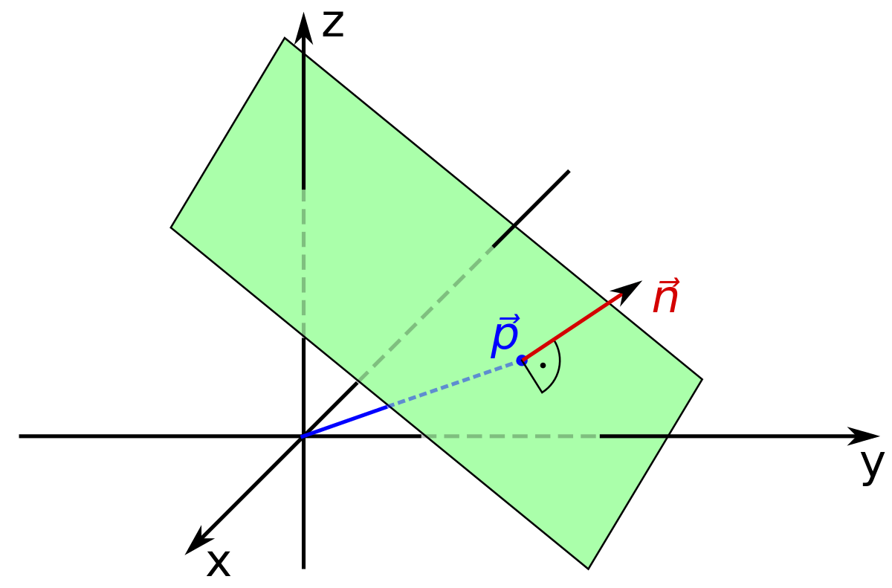
CUM FUNCTIONEAZĂ
[avem nevoie de o suprafață plană]

Slide 22
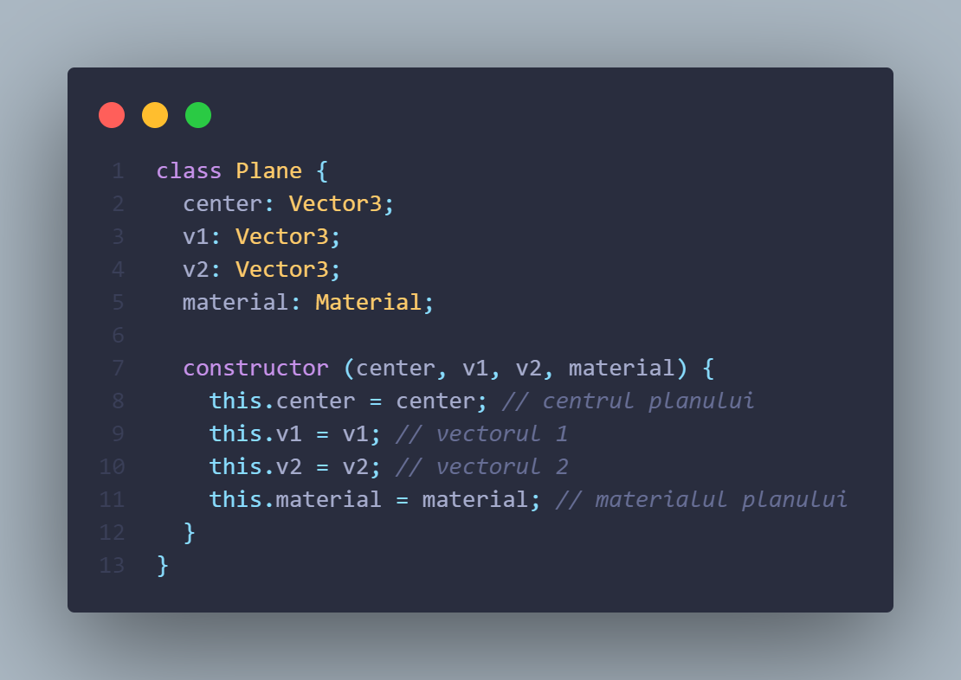
IMPLEMENTARE PLAN

Slide 23
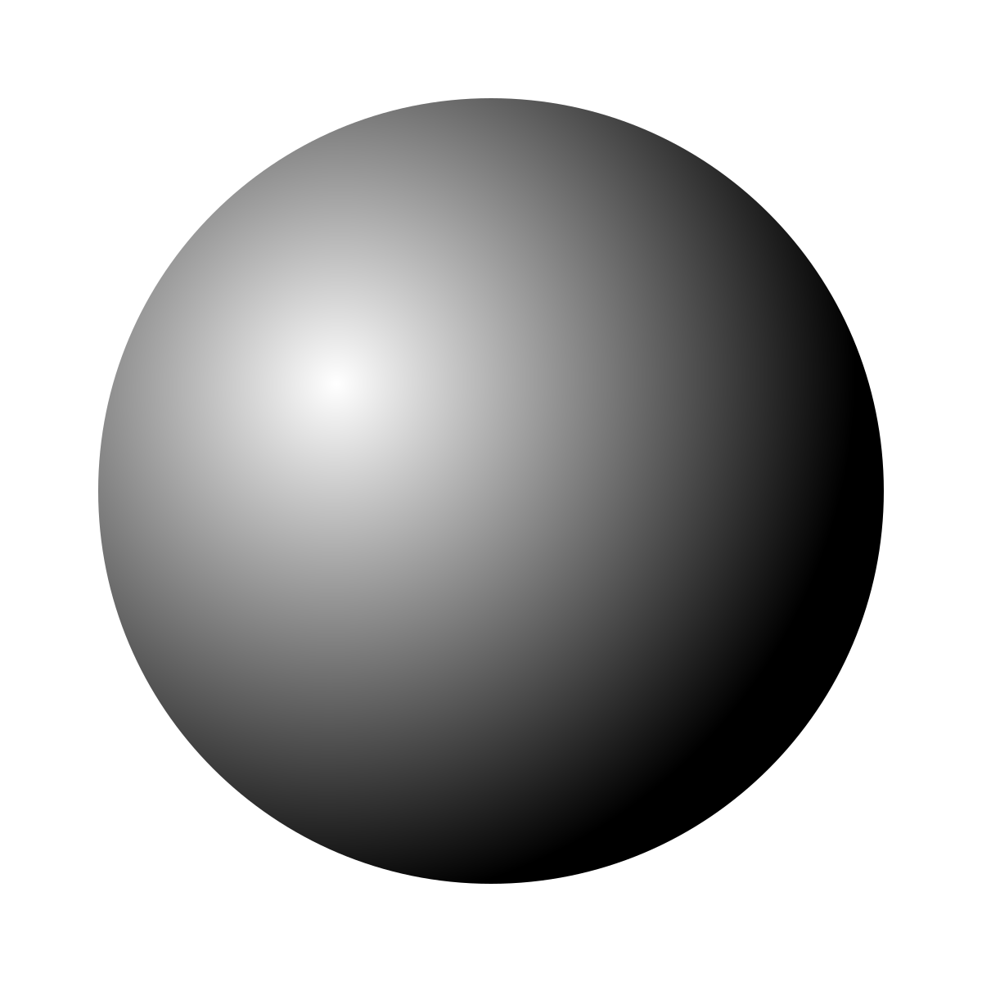
CUM FUNCTIONEAZĂ
[avem nevoie de o sferă]

Slide 24
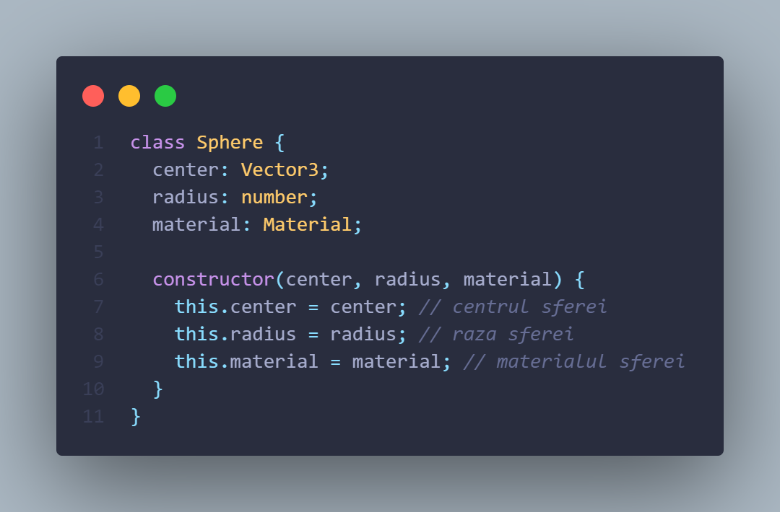
IMPLEMENTARE SFERĂ

Slide 25
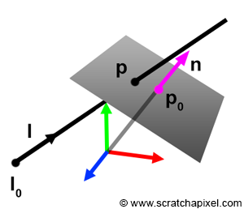
CUM FUNCTIONEAZĂ
[calculul intersecției unei raze cu planul]

Slide 26
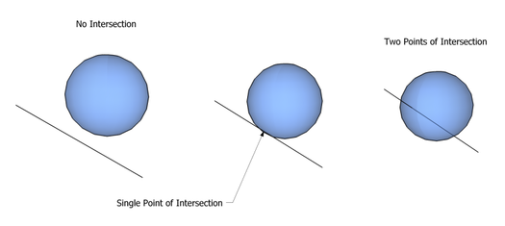
CUM FUNCTIONEAZĂ
[calculul intersecției unei raze cu sfera]

Slide 27
BIBLIOGRAFIE – IMPLEMENTARE ALGORITM
https://www.scratchapixel.com/lessons/3d-basic-rendering/introduction-to-ray-tracing/how-does-it-work [18 Aprilie 2022]
https://www.scratchapixel.com/lessons/3d-basic-rendering/introduction-to-ray-tracing/raytracing-algorithm-in-a-nutshell [18 Aprilie 2022]
https://www.scratchapixel.com/lessons/3d-basic-rendering/introduction-to-ray-tracing/implementing-the-raytracing-algorithm [18 Aprilie 2022]
https://github.com/ercang/raytracer-js [22 Aprilie 2022]
https://www.scratchapixel.com/lessons/3d-basic-rendering/minimal-ray-tracer-rendering-simple-shapes/minimal-ray-tracer-rendering-spheres [2 Mai 2022]
https://www.scratchapixel.com/lessons/3d-basic-rendering/minimal-ray-tracer-rendering-simple-shapes/ray-plane-and-ray-disk-intersection [2 Mai 2022]
https://github.com/iechevarria/ray-tracer-js [8 Mai 2022]
BIBLIOGRAFIE – IMPLEMENTARE ALGORITM
https://www.scratchapixel.com/lessons/3d-basic-rendering/introduction-to-ray-tracing/how-does-it-work [18 Aprilie 2022]
https://www.scratchapixel.com/lessons/3d-basic-rendering/introduction-to-ray-tracing/raytracing-algorithm-in-a-nutshell [18 Aprilie 2022]
https://www.scratchapixel.com/lessons/3d-basic-rendering/introduction-to-ray-tracing/implementing-the-raytracing-algorithm [18 Aprilie 2022]
https://github.com/ercang/raytracer-js [22 Aprilie 2022]
https://www.scratchapixel.com/lessons/3d-basic-rendering/minimal-ray-tracer-rendering-simple-shapes/minimal-ray-tracer-rendering-spheres [2 Mai 2022]
https://www.scratchapixel.com/lessons/3d-basic-rendering/minimal-ray-tracer-rendering-simple-shapes/ray-plane-and-ray-disk-intersection [2 Mai 2022]
https://github.com/iechevarria/ray-tracer-js [8 Mai 2022]

Slide 28
BIBLIOGRAFIE – IMPLEMENTARE ALGORITM
https://www.scratchapixel.com/lessons/3d-basic-rendering/introduction-to-ray-tracing/how-does-it-work [18 Aprilie 2022]
https://www.scratchapixel.com/lessons/3d-basic-rendering/introduction-to-ray-tracing/raytracing-algorithm-in-a-nutshell [18 Aprilie 2022]
https://www.scratchapixel.com/lessons/3d-basic-rendering/introduction-to-ray-tracing/implementing-the-raytracing-algorithm [18 Aprilie 2022]
https://github.com/ercang/raytracer-js [22 Aprilie 2022]
https://www.scratchapixel.com/lessons/3d-basic-rendering/minimal-ray-tracer-rendering-simple-shapes/minimal-ray-tracer-rendering-spheres [2 Mai 2022]
https://www.scratchapixel.com/lessons/3d-basic-rendering/minimal-ray-tracer-rendering-simple-shapes/ray-plane-and-ray-disk-intersection [2 Mai 2022]
https://github.com/iechevarria/ray-tracer-js [8 Mai 2022]
BIBLIOGRAFIE – IMAGINI PREZENTARE POWERPOINT
https://images.anandtech.com/doci/15013/14%20-%20On_678x452.jpg
https://upload.wikimedia.org/wikipedia/commons/thumb/8/83/Ray_trace_diagram.svg/1200px-Ray_trace_diagram.svg.png
https://upload.wikimedia.org/wikipedia/commons/1/1a/D%C3%BCrer_-_Man_Drawing_a_Lute.jpg
https://preview.redd.it/1j4y3hz9mr131.png?width=960&crop=smart&auto=webp&s=1da400830ad38402a84e6c763d7fcdc473041196
https://logolook.net/wp-content/uploads/2021/06/Minecraft-Logo.png
https://assets2.rockpapershotgun.com/control1.jpg/BROK/resize/880%3E/format/jpg/quality/80/control1.jpg
https://cutewallpaper.org/24/control-png/control-remedy.png
https://images5.alphacoders.com/638/thumb-1920-638820.jpg
https://image.api.playstation.com/vulcan/img/rnd/202010/2122/yGwOrNzL0tM7ENOWPVXKPghP.png
https://cdnb.artstation.com/p/assets/images/images/013/585/075/large/abdelrahman-kubisi-main-final.jpg?1540281069
https://cdna.artstation.com/p/assets/images/images/013/585/076/original/abdelrahman-kubisi-process.gif?1540280812

Slide 29
BIBLIOGRAFIE – IMPLEMENTARE ALGORITM
https://www.scratchapixel.com/lessons/3d-basic-rendering/introduction-to-ray-tracing/how-does-it-work [18 Aprilie 2022]
https://www.scratchapixel.com/lessons/3d-basic-rendering/introduction-to-ray-tracing/raytracing-algorithm-in-a-nutshell [18 Aprilie 2022]
https://www.scratchapixel.com/lessons/3d-basic-rendering/introduction-to-ray-tracing/implementing-the-raytracing-algorithm [18 Aprilie 2022]
https://github.com/ercang/raytracer-js [22 Aprilie 2022]
https://www.scratchapixel.com/lessons/3d-basic-rendering/minimal-ray-tracer-rendering-simple-shapes/minimal-ray-tracer-rendering-spheres [2 Mai 2022]
https://www.scratchapixel.com/lessons/3d-basic-rendering/minimal-ray-tracer-rendering-simple-shapes/ray-plane-and-ray-disk-intersection [2 Mai 2022]
https://github.com/iechevarria/ray-tracer-js [8 Mai 2022]
http://assets.sbnation.com/assets/2820593/pixar-before-after.jpg
https://www.candyrific.com/res/uploads/brands/logos/color/Monsters-U-logo.png
https://i.pcmag.com/imagery/articles/04Er6LW8YPsfh2pmHEghbK7-5.fit_lim.size_960x.jpg
https://upload.wikimedia.org/wikipedia/commons/3/32/Shadow_of_the_Tomb_Raider.png
https://www.scratchapixel.com/images/upload/ray-tracing-refresher/rt-setup2.png?
https://www.mauriciopoppe.com/images/ray-tracing!orthographic.jpg
https://www.scratchapixel.com/images/upload/shading-intro2/shad2-globalillum5.png?
https://static.techspot.com/articles-info/1888/images/2019-08-11-image-8-p_1100.webp
https://www.scratchapixel.com/images/upload/introduction-to-ray-tracing/lighttoeyebounce.png
https://www.scratchapixel.com/images/upload/introduction-to-ray-tracing/tracefromeyetolight.gif
https://mathinsight.org/media/image/image/vector_parallelogram_law.png
https://www.pngall.com/wp-content/uploads/8/Metal-Ball-PNG-Free-Download.png
https://cdn.picpng.com/arrow/arrow-left-back-backwards-sign-106696.png
https://upload.wikimedia.org/wikipedia/commons/thumb/f/f9/Plane_equation_qtl3.svg/1200px-Plane_equation_qtl3.svg.png
https://www.scratchapixel.com/images/upload/ray-simple-shapes/plane.png?
https://upload.wikimedia.org/wikipedia/commons/thumb/7/7e/Sphere_-_monochrome_simple.svg/1200px-Sphere_-_monochrome_simple.svg.png
https://upload.wikimedia.org/wikipedia/commons/6/67/Line-Sphere_Intersection_Cropped.png

